Slide 1
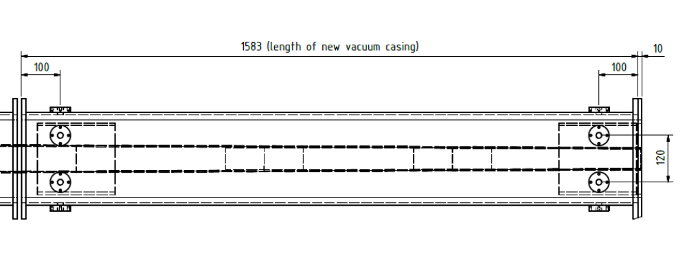
Upper regulation screws

